Slide 1


Mechanical Engineering Drawing
ME-174
Auxiliary Views
Course Teachers:
Sadia Tasnim, Lecturer
Taslima Hossain Sanjana, Adj. Lecturer

Slide 2
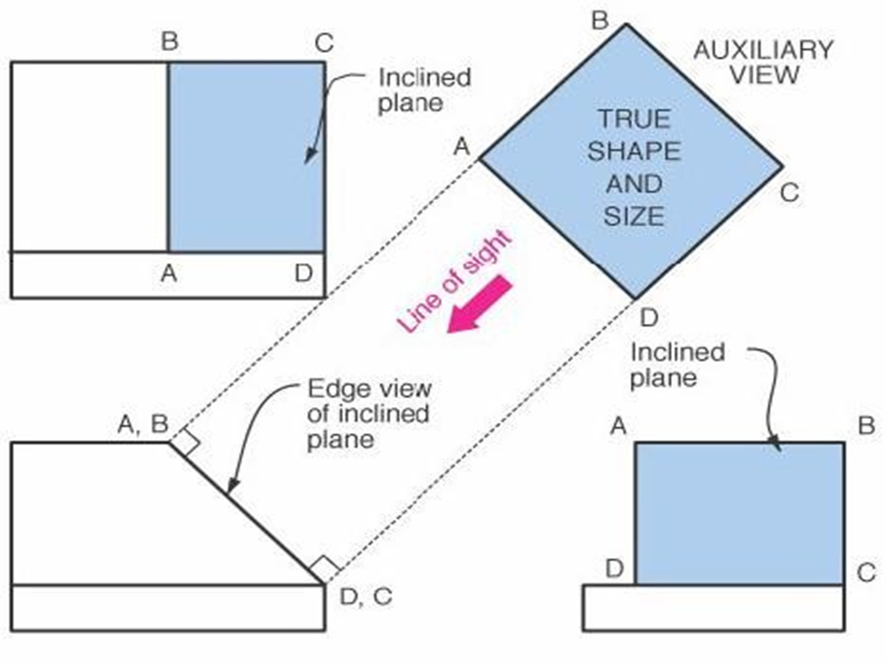
What is Auxiliary View ?
An auxiliary view is an orthographic view taken so that the lines of sight are not parallel to the principal projection planes.
An auxiliary view is not one of the six principal views.

Slide 3
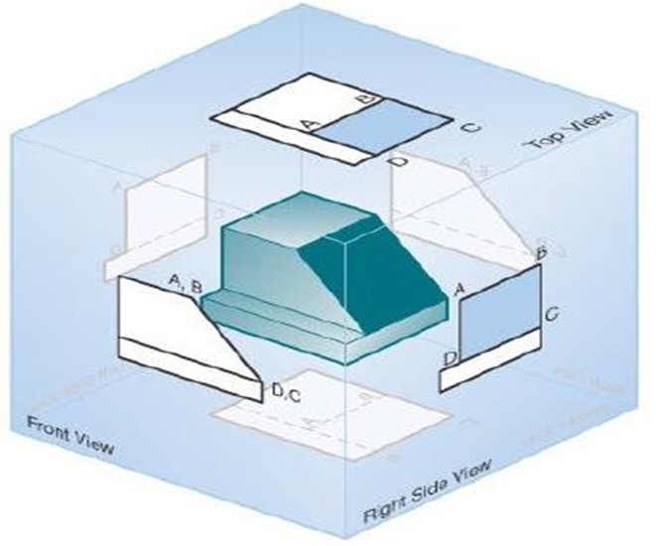
Why Auxiliary View ?
When creating engineering drawings, it is often necessary to show features in a view where they appear true size so that they can be dimensioned.
Many objects are quite complex, and the three principal views may not best present the geometry of the part.
Auxiliary View = additional view
When the glass box is unfolded, resulting in the six principal views. However, when the six views are created, surface ABCD never appears true size and shape.

Slide 4
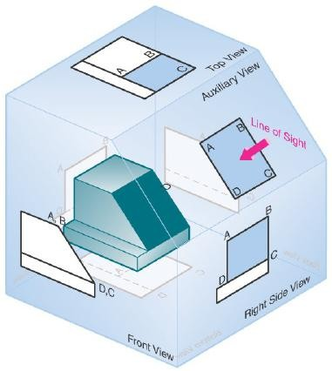
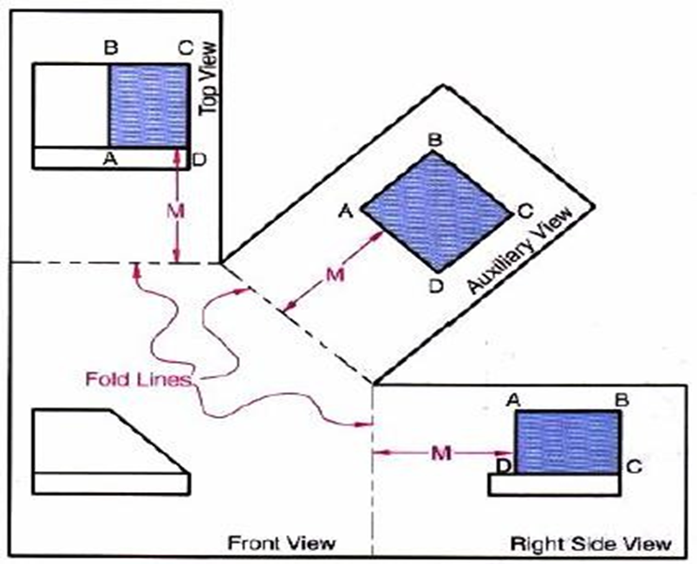
Why Auxiliary View ?
The object suspended inside a glass box, which has a special or auxiliary plane that is parallel to inclined surface ABCD.
The line of sight required to create the auxiliary view is perpendicular to the new projection plane and to surface ABCD
Now, surface ABCD is shown in true size and shape and is located at distance M from the fold line.

Slide 5
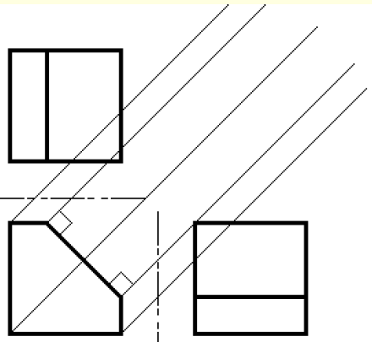
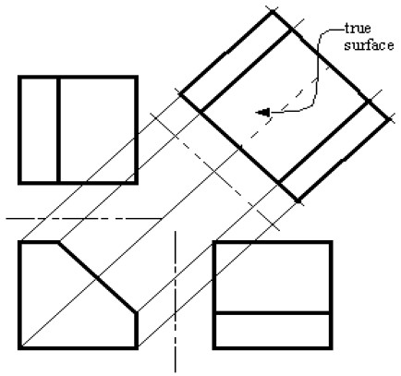
How to Draw

Slide 6
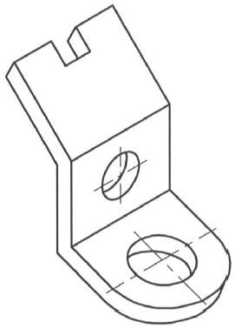
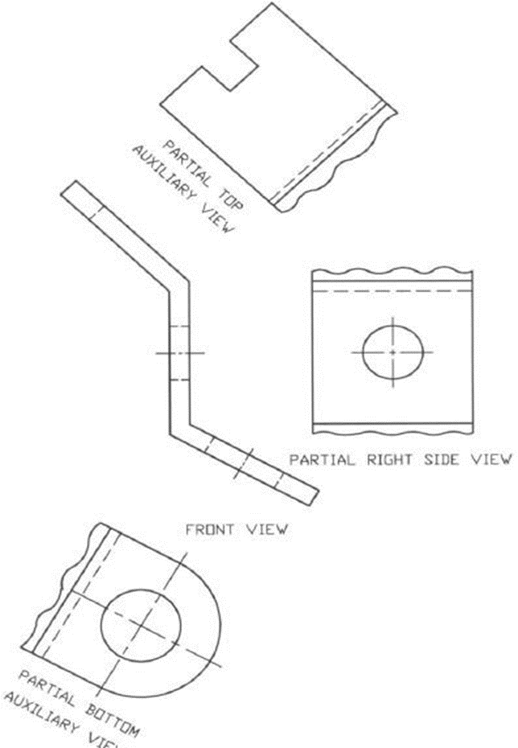
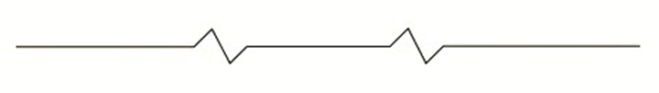
Partial auxiliary view
In auxiliary views, it is normal practice not to project hidden features or other features that are not part of the inclined surface. When only the details for the inclined surface are projected and drawn in the auxiliary view, the view is called a partial auxiliary view.
Let’s see an example !
10
10
19-38
19-38
19-38
Break line: To show a break on the object. It shortens the view of a long part.

Slide 7
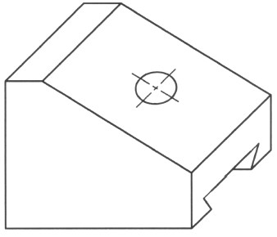
Auxiliary view
( with circular feature)
Object with Inclined Surface Containing a Hole

Slide 8
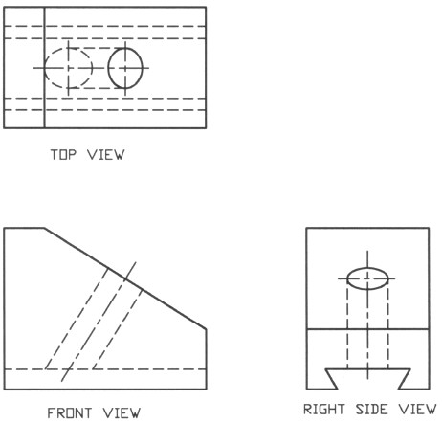
Auxiliary view
( with circular feature)
Regular Orthographic Views will create a problem – circle will be elliptic

Slide 9
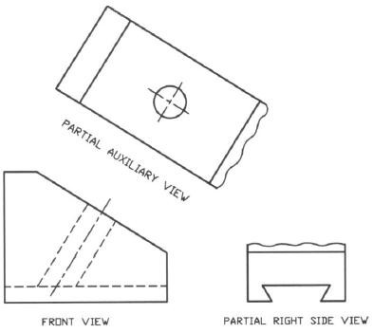
Auxiliary view
( with circular feature)
Partial Auxiliary Views :

Slide 10
Lines
Object Line : 100% thick
Hidden Line: 50% thick
Dimension, Extension Line: 25% thick
Center Line : 50% thick
Cutting Plane Line : 125% thick
Hatchet line :25% thick
Break line : 25% thick

Slide 11
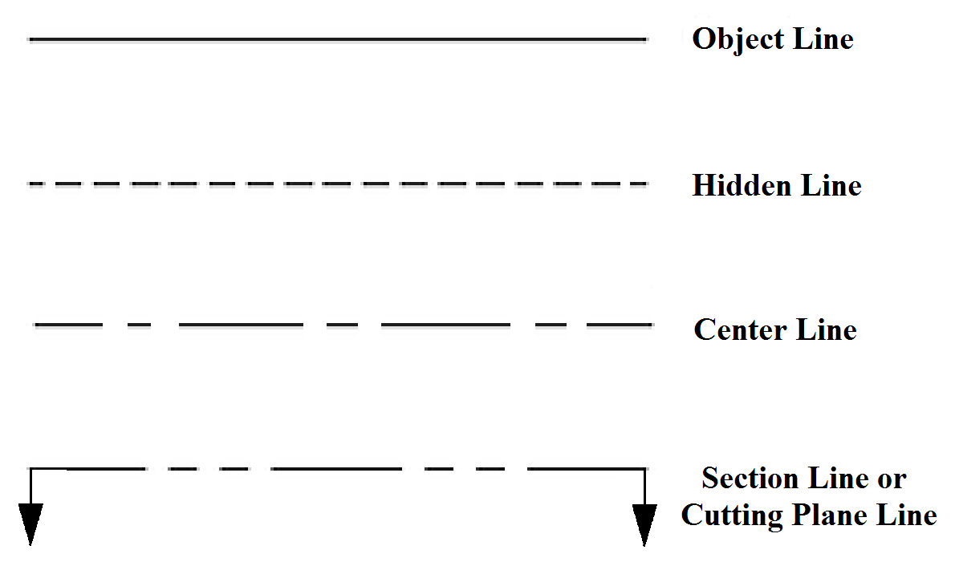
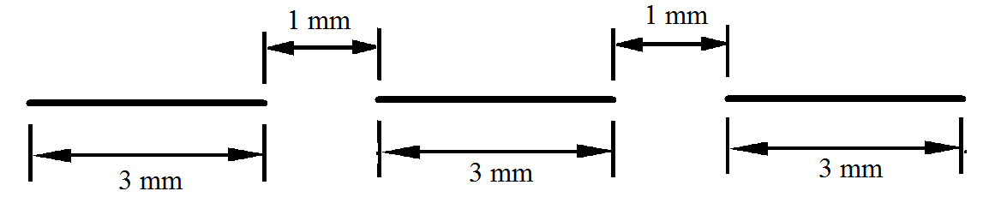
100 %
Thickness:
Thickness: 50 %
Thickness: 50 %

Slide 12

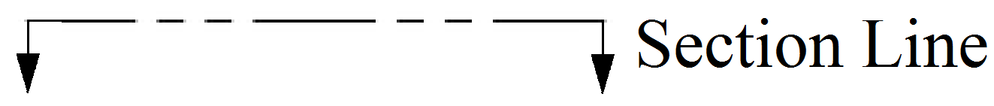
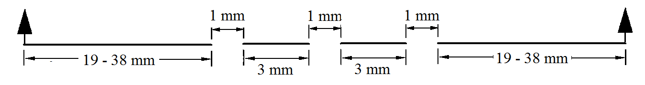
Thickness: 25 %
Thickness:
125 %
N.B.: All Percentages are with respect to the object line
17

Slide 13
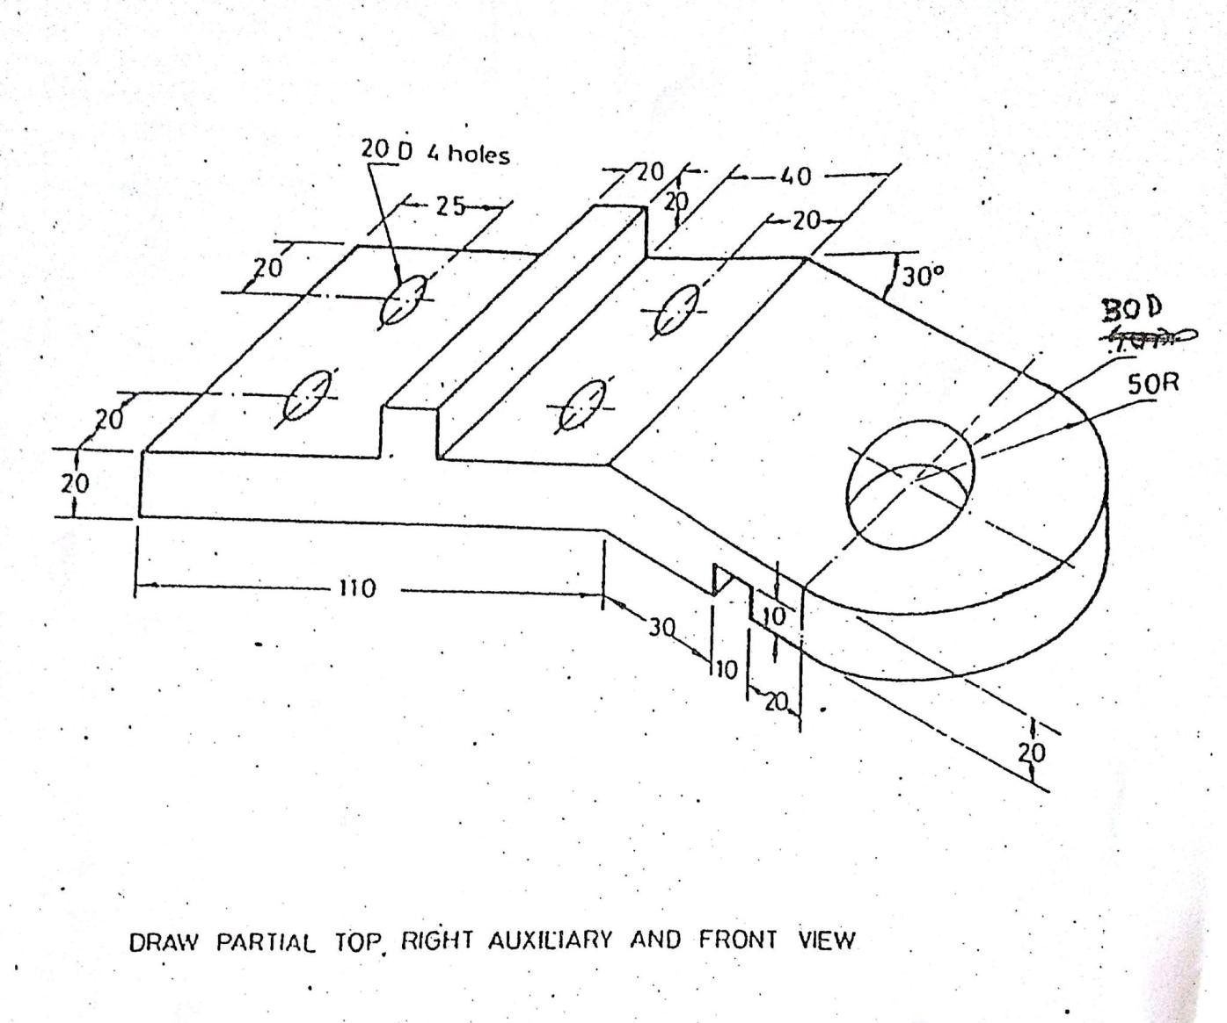
First Problem

Slide 14
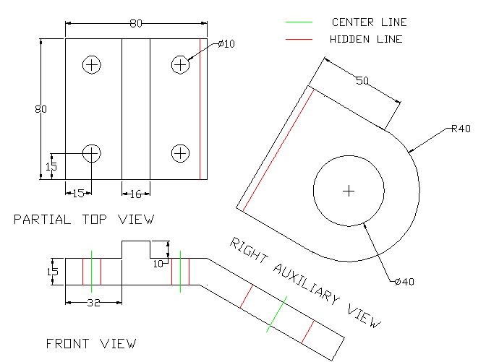
First Problem

Slide 15
Persist Until Succeed !!!

